Slide 1
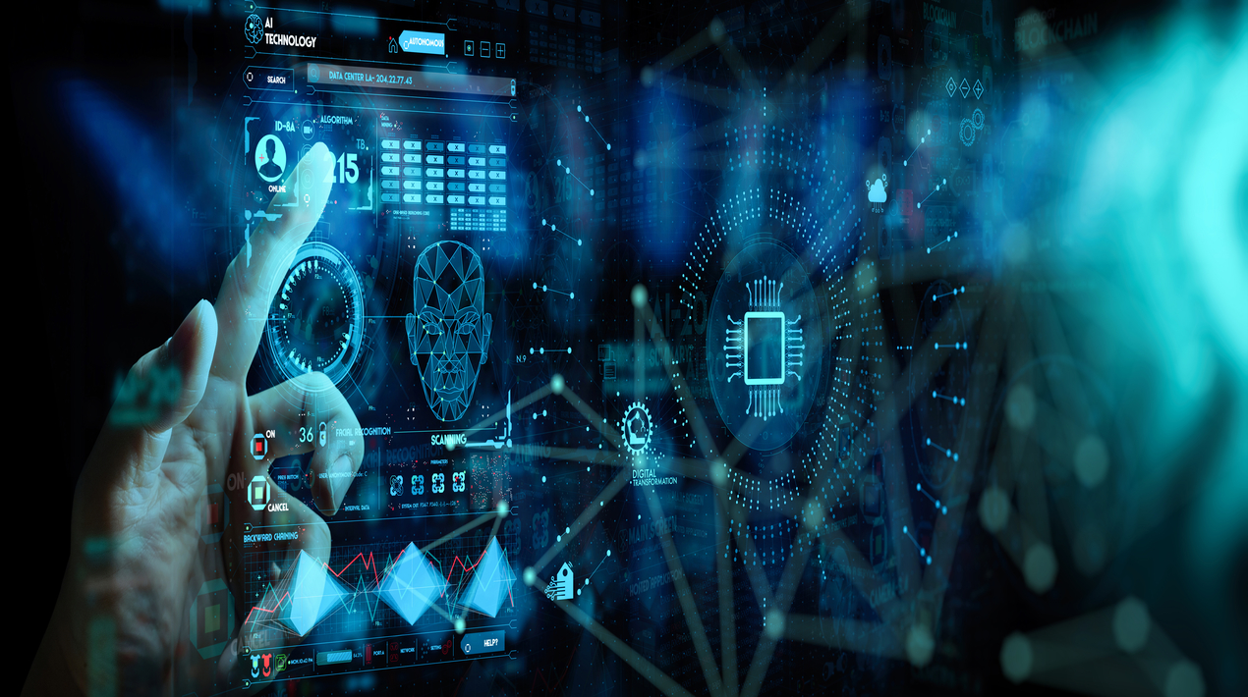


Computer Vision for Corner Detection
HAND GESTURE RECOGNITION
Guided By : Work Done By:
Dr.S.Christy Shashikanth.S
(Course Faculty) Saibalaji.N
Computer Vision Vardhini.S
Saveetha School of Engineering

Slide 2
ABSTRACT
Hand gesture recognition using computer vision has gained significant attention due to its diverse applications in human-computer interaction, sign language interpretation, and virtual reality systems.
This presentation provides an overview of the foundational concepts and recent advancements in this field. It discusses the methodologies ranging from traditional techniques like template matching to sophisticated deep learning models such as convolutional neural networks (CNNs) and recurrent neural networks (RNNs), highlighting their strengths and limitations.

Slide 3
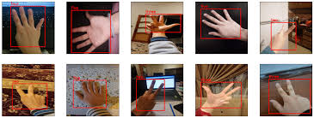
INTRODUCTION
Hand gesture recognition using computer vision is a dynamic field at the intersection of artificial intelligence and human-computer interaction.
It involves the detection and interpretation of hand movements and gestures through visual data captured by cameras.
This technology enables natural and intuitive interaction between humans and machines, with applications ranging from virtual reality gaming to assistive technologies for individuals with disabilities.
In this presentation, we will delve into the fundamentals, methodologies, challenges, and future prospects of hand gesture recognition using computer vision techniques.

Slide 4



Materials and Methods:
Platforms:-
Anaconda or Google Collab
Libraries:-
Opencv-tensorflow-sklearn-mediapipe
Algorithms:-
Long Short Term Memory(LSTM)

Slide 5
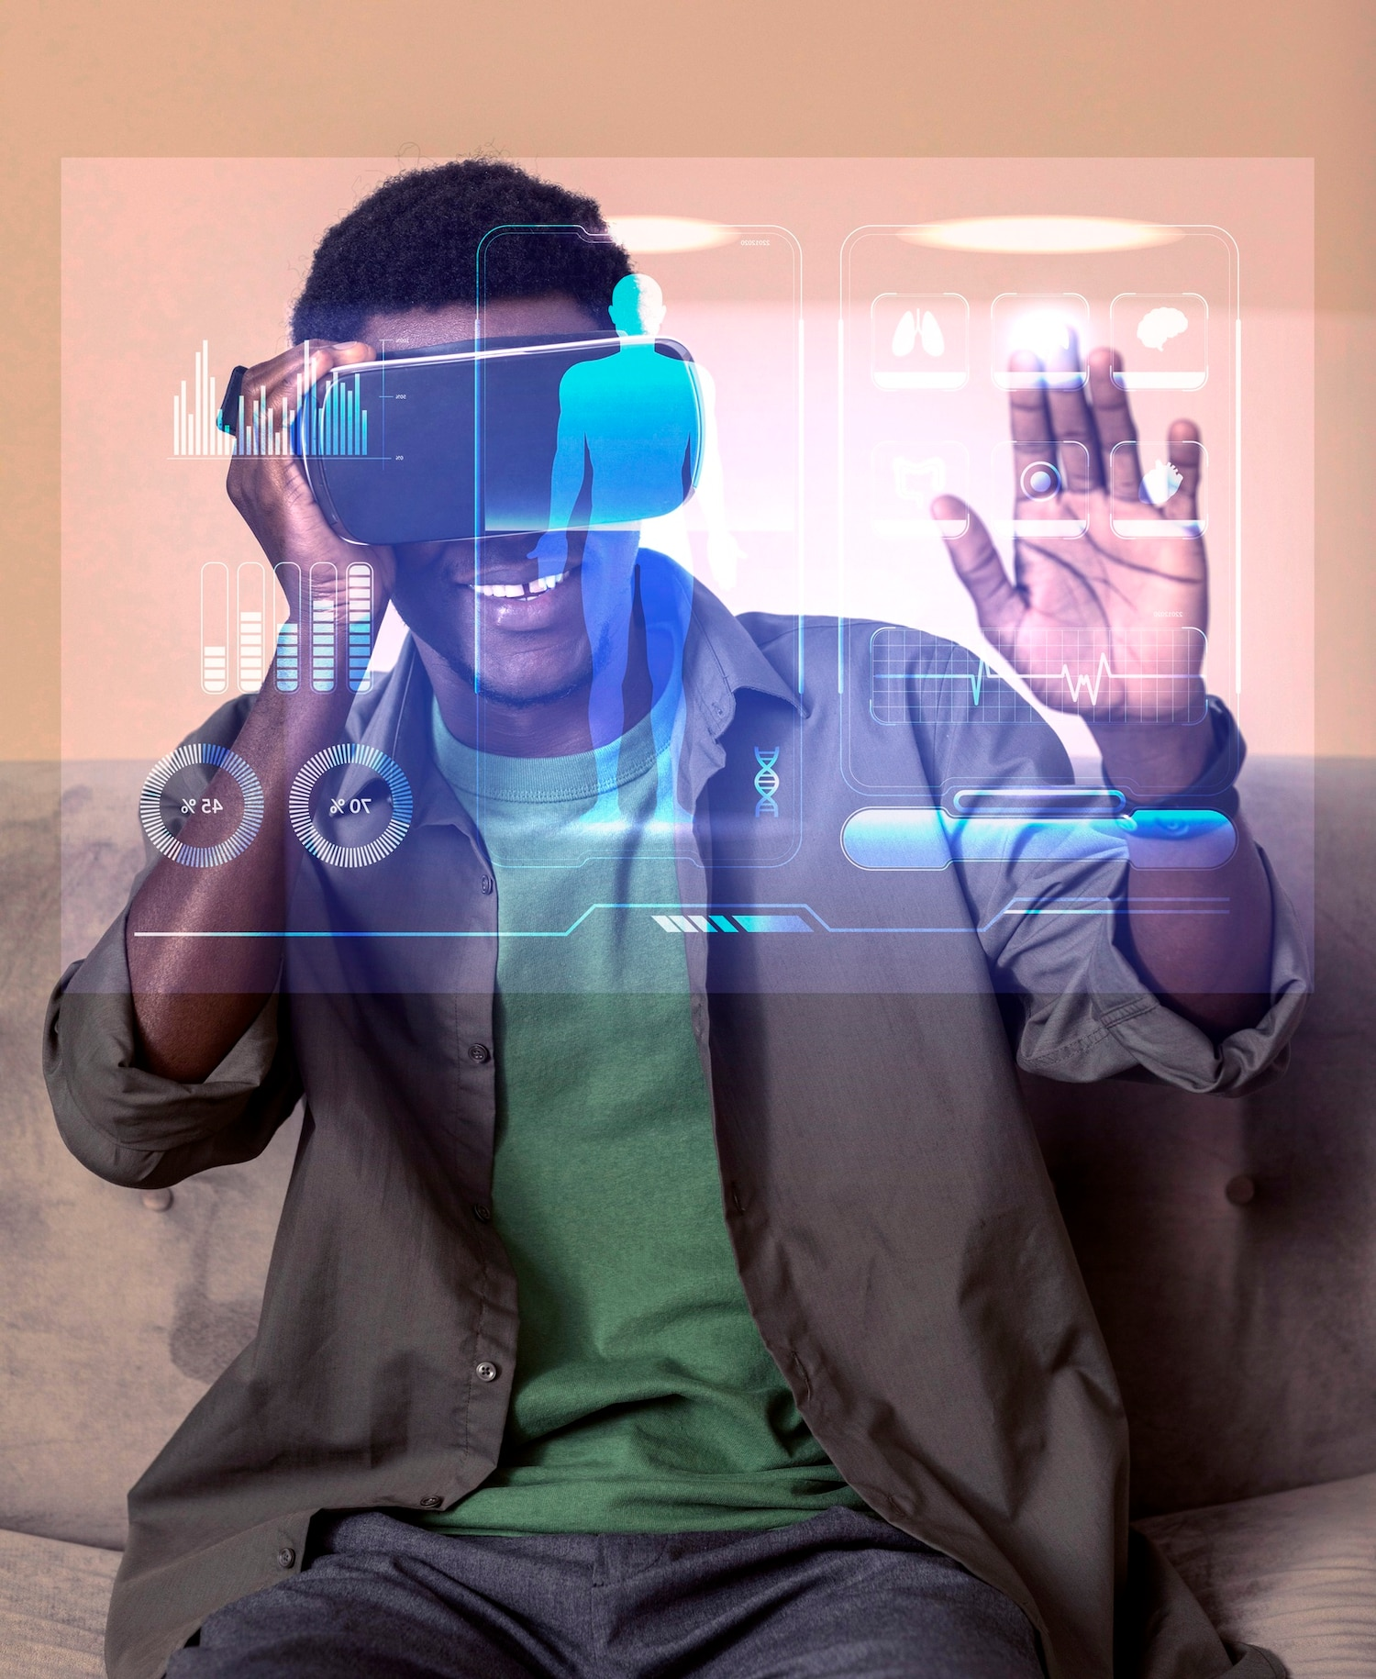
Implications of Hand Gesture Recognition
Enhanced Human-Computer Interaction: Hand gesture recognition revolutionizes how humans interact with computers, enabling natural and intuitive interfaces.
Accessibility and Inclusivity: Gesture-based interfaces offer accessibility features for individuals with disabilities, facilitating communication and interaction.
Advancements in Technology: The development of robust gesture recognition algorithms drives advancements in computer vision, machine learning, and sensor technologies.

Slide 6
Challenges in Hand Gesture Recognition
Variations in Lighting Conditions: Performance may degrade in varying lighting environments, necessitating robust illumination invariant techniques.
Occlusions: Hand gestures may be partially occluded, leading to misinterpretation or incomplete recognition. Advanced algorithms are required to handle occlusions effectively.
Complex Hand Poses: Recognizing gestures involving intricate hand configurations poses a challenge, demanding sophisticated feature extraction and classification methods.
Real-time Processing: Achieving real-time performance for interactive applications requires efficient algorithms and hardware acceleration.

Slide 7
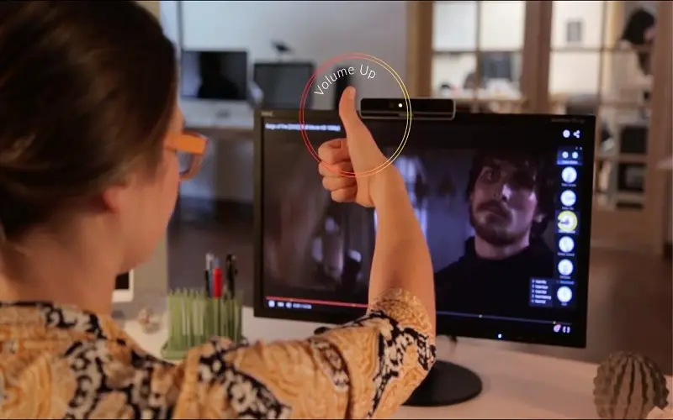
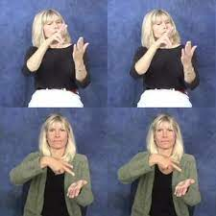
APPLICATIONS
Human-Computer Interaction (HCI):
Gesture-based interfaces in smartphones, tablets, and computers for intuitive control and navigation.
Gesture-controlled presentations and gaming consoles for immersive user experiences.
Sign Language Recognition:
Real-time translation of sign language into text or speech for improved communication accessibility.
Assistive technologies for individuals with hearing impairments, facilitating communication in various settings.

Slide 8
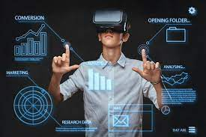
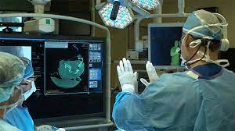
Virtual Reality (VR) and Augmented Reality (AR):
Gesture-based interactions in VR/AR environments for intuitive manipulation of virtual objects.
Virtual training simulations for industries such as healthcare, aviation, and manufacturing, enhancing training effectiveness.
Healthcare and Rehabilitation:
Monitoring and analyzing hand gestures during rehabilitation exercises for real-time feedback and progress tracking.
Gesture-controlled medical devices and interfaces for hands-free operation in surgical settings.

Slide 9
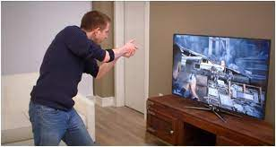
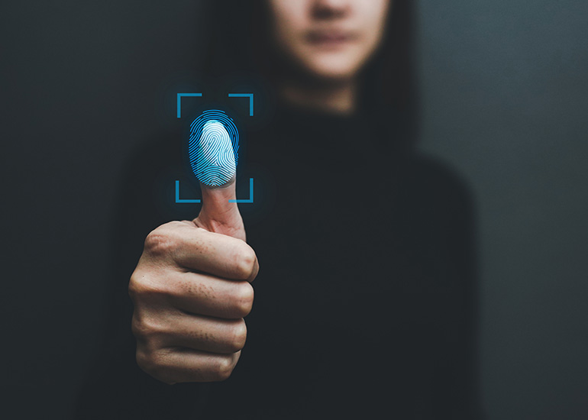
Gaming and Entertainment:
Gesture-based gaming experiences for interactive gameplay and immersive storytelling.
Interactive installations and entertainment exhibits leveraging gesture recognition for engaging user experiences.
Security and Surveillance:
Gesture recognition for biometric authentication in security systems, enhancing access control and identity verification.
Surveillance systems utilizing gesture analysis for identifying suspicious behaviors and events.

Slide 10
CONCLUSION
Hand gesture recognition presents transformative opportunities for human-computer interaction, but also raises ethical, social, and technical considerations. Addressing these challenges while leveraging the potential of gesture recognition technologies will shape its responsible and impactful deployment in various domains.
Fast detection process, allows the real time video application with low cost sensors, such as PC and USB camera

Slide 11
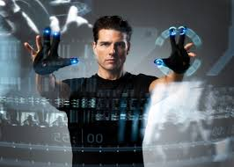
FUTURE SCOPE
Enhanced Interaction: Users can easily interact with virtual items and interfaces by using hand gestures.
Wearable Control: Wearable technology can be operated by using hand gestures.
Gestural UI Design: User interface (UI) design will change to support gesture-based interactions when hand gestures are integrated into Augmented Reality and wearables.
Virtual Object Manipulation: In augmented reality environments, hand gestures can allow for precise and lifelike interaction of virtual objects.
Social Interactions: By providing gestures for communication, teamwork, or shared experiences, hand gestures in AR and wearables can promote social interactions.

Slide 12
REFERENCES:
http://www.rroij.com/open-access/hand-gesture-recognition-- analysis-ofvarious-techniques-methods-and- theiralgorithms.php?aid=50613
https://www.grin.com/document/369514
https://www.slideshare.net/adi23s/gesture-recognition-adi- 37645936?from_action=save

